Slide 1
MCA Final Year Project (Review II)
E-SAHAKARA (Initialization and configuration, General Ledger & Financial Statements)
Submitted to the Presidency University, Bengaluru in partial fulfillment for the award of the degree of Master of Computer Applications(MCA)
Project Number : MCA_PR218
Ass
Under the supervision of
Mr. S. Shakthi
Asst. Prof of SCSE
Presidency University, Bengaluru
Name | Roll Number
Shubhan G C | 20232MCA0194

Slide 2
Content
Abstract
Problem Statement
Literature Survey
Tools and Technologies to be used
References
GitHub Link

Slide 3
Problem Statement
Lack of Standardized Setup - Cooperative societies struggle with inconsistent system configurations, leading to operational inefficiencies and compliance issues.
Data Validation Issues – The absence of automated validation mechanisms results in inaccurate member and financial records, impacting decision-making
Inaccurate Financial Tracking – Manual bookkeeping leads to errors in transaction records, affecting financial integrity and decision-making.
Audit and Reporting Challenges – The absence of structured audit trails makes financial verification and reporting cumbersome, increasing the risk of discrepancies.

Slide 4

Screenshots
Login Page

Slide 5
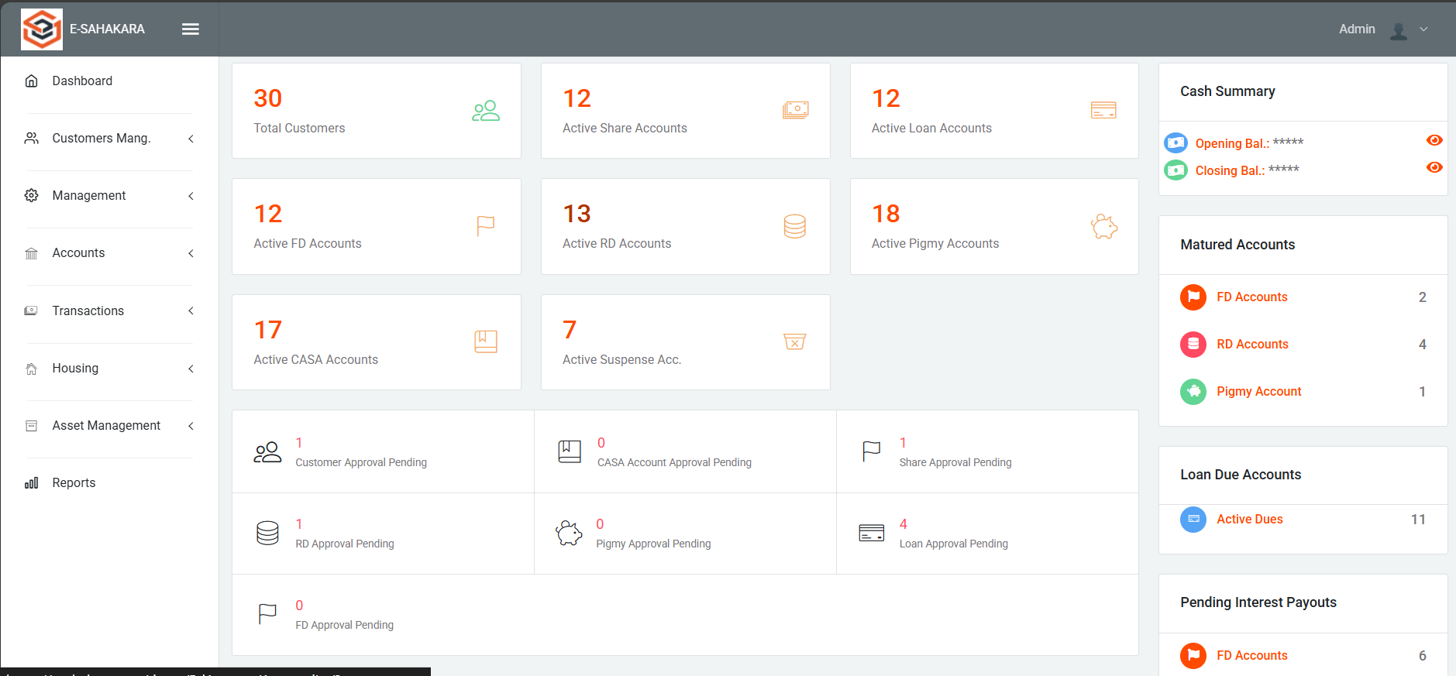
Dashboard

Slide 6
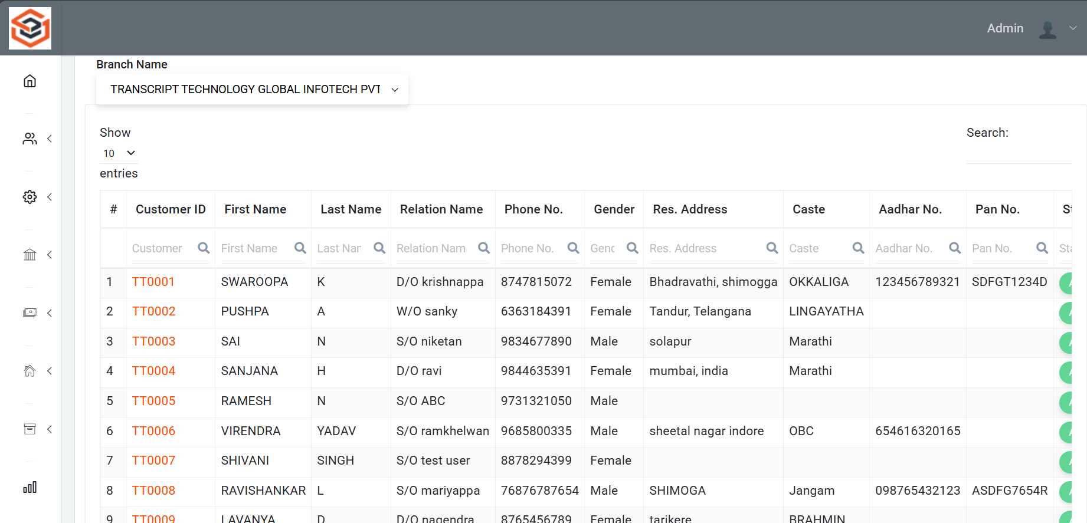
Customer list

Slide 7
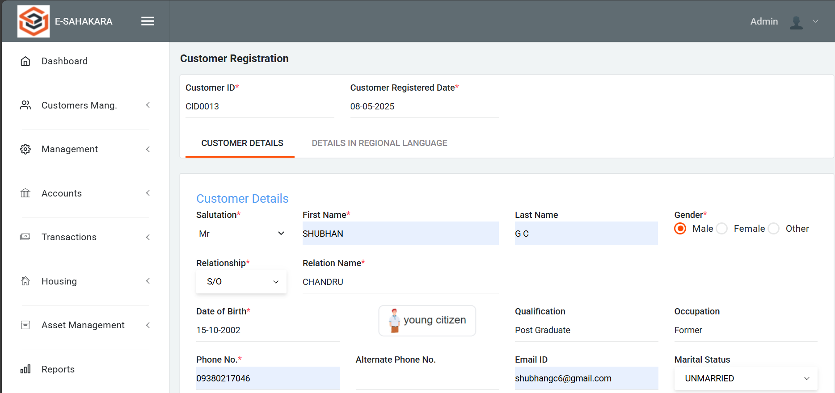
Customer Registration Form

Slide 8
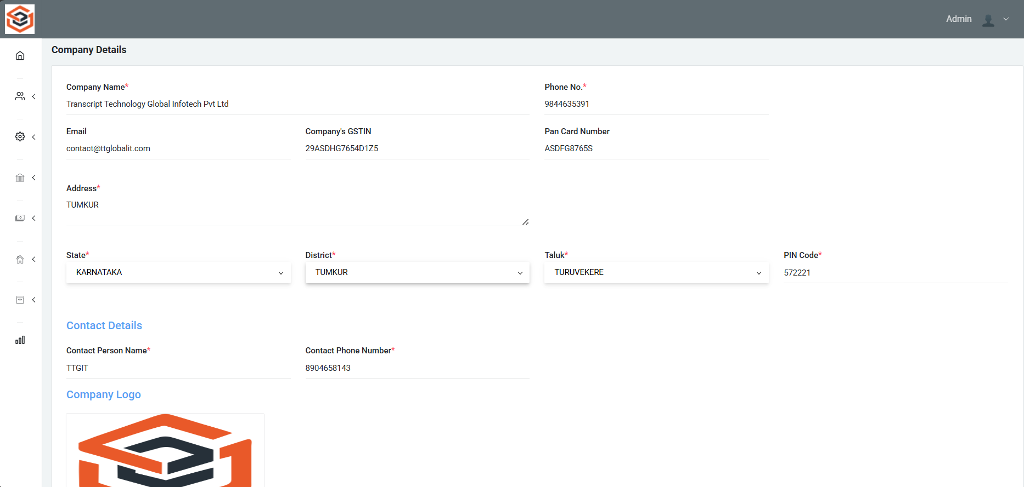
Company Details

Slide 9
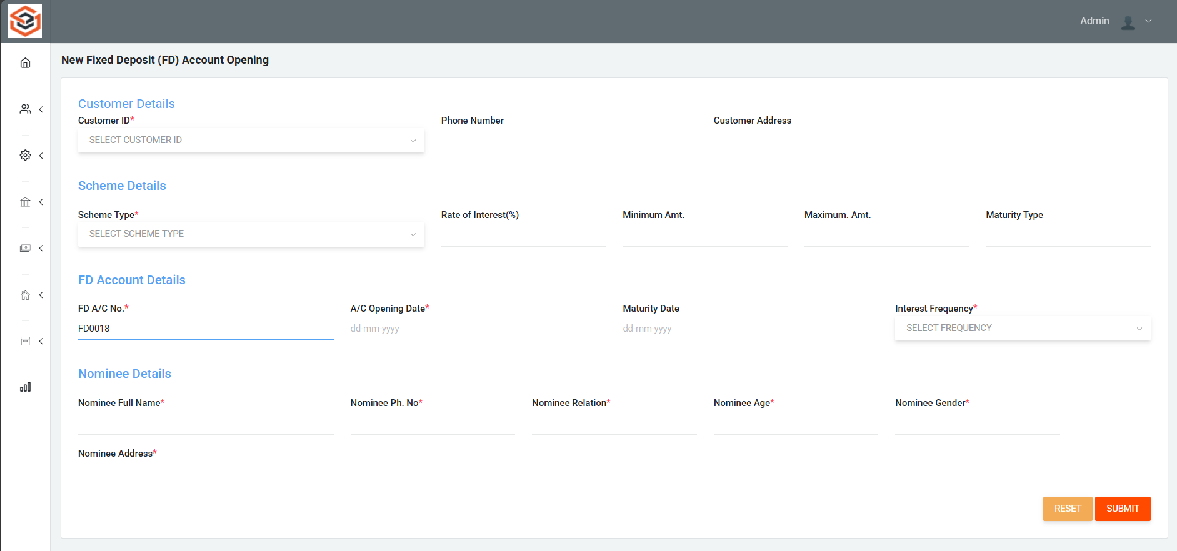
FD Account opening page

Slide 10
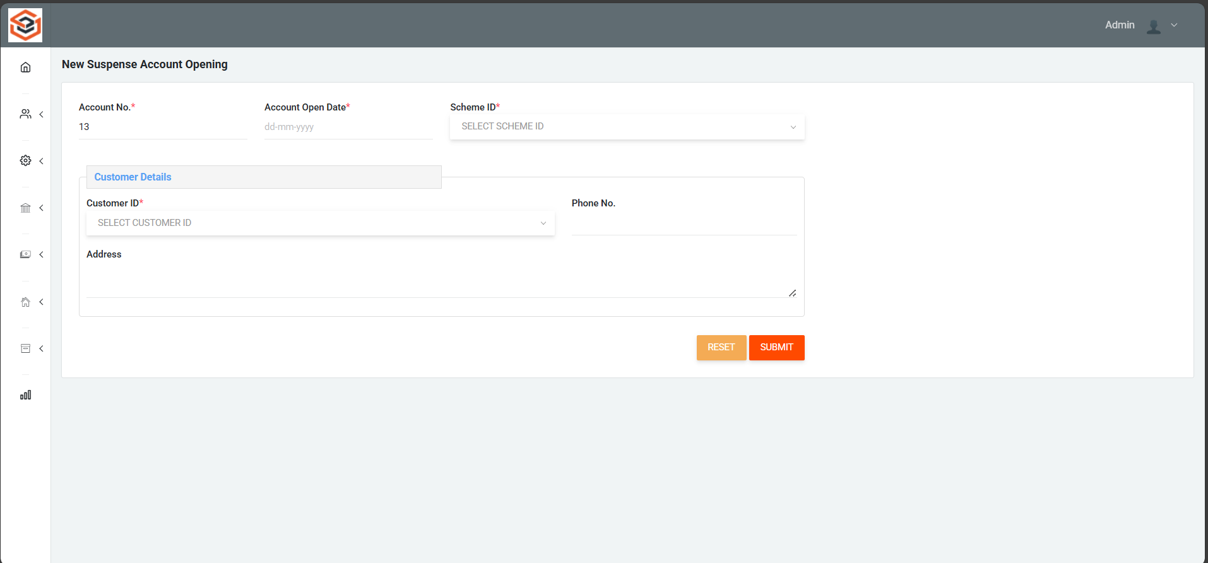
Suspense Account opening page

Slide 11
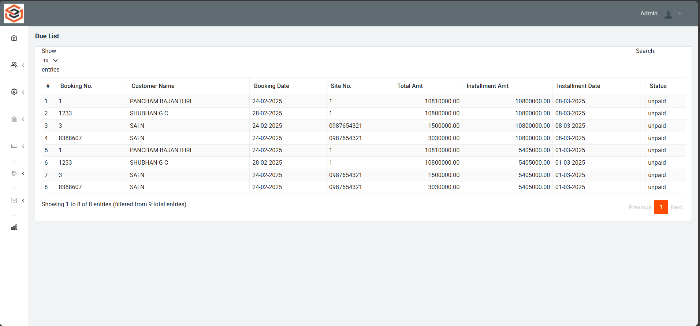
Loan Due List page

Slide 12
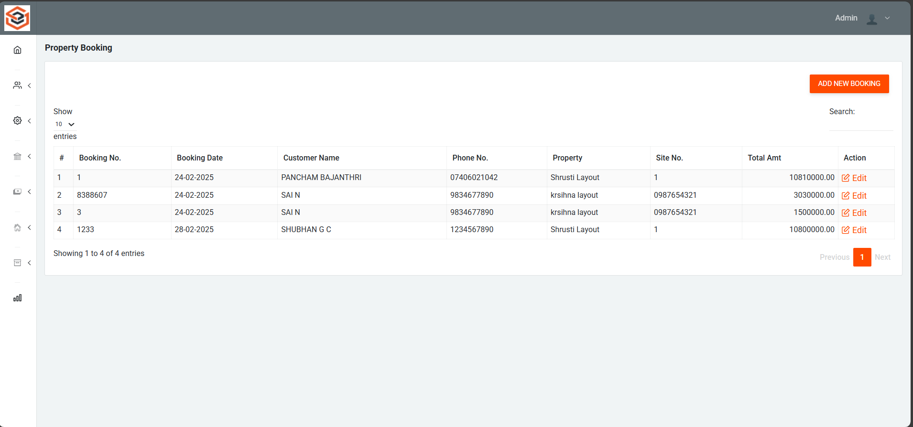
Property Booking Page

Slide 13
Loan Due List page

Slide 14
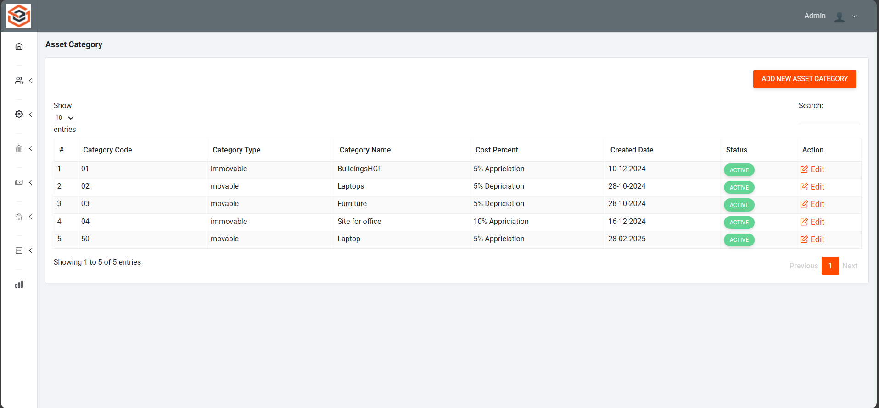
Asset Category List

Slide 15
References
Digitalisation and Digital Transformation in the Social Economy: The Cases of Anecoop and Consum https://www.emerald.com/insight/content/doi/10.1108/BFJ-12-2022-1086/full/html
Digital Transformation in Indian Co-operative Banks https://www.tannum.io/2024/08/26/digital-transformation-in-indian-co-operative-banks/
Digital Transformation and Financial Performance of Deposit-Taking Savings and Credit Co-Operatives in Nairobi City County, Kenya https://edinburgjournals.org/journals/index.php/journal-of-finance-and-accountin/article/view/172

Slide 16
Github Link
GitHub Repository:
https://github.com/Shubhangc6/E-Sahakara

Slide 17


